Slide 1
Online Quiz System
Submitted By,
Amitkumar Ashokbhai Tank
Exam No. :- 10
November-2009
Submitted to
Institute of Science & Technology
For
Advanced Study & Research

Slide 2
Contents
Online Quiz System
Introduction
Module Description
Objective
Resource Requirement
Applicability
Limitation
Future Enhancements
Data Flow Diagram
System Output

Slide 3
Introduction
Online Quiz System
This application is designed to conduct online exam. Due to various problems encountered in manual exam, this system is designed to automate the present manual exam system and also to speed up the manual operations like set question paper, take exam, calculation and generate result and various activities of the exam. If power can get turn off or any server problem between any where the system then Student have to answer only that question which are not answered by him/her because of problem.

Slide 4
Module Description
Online Quiz System
Administrator Module
Admin can Add & Delete Class.
Admin can Add & Delete Subject.
Admin can Create Student Account
Admin can Create Faculty Account
Admin can See & print Report of taken Exam.
Admin can Change their Account Password.

Slide 5
Module Description
Online Quiz System
Faculty Module
Faculty can Add Question.
Faculty can Conduct Exam/Quiz.
Faculty can Change their Account Password.
Faculty can See & Print taken Exam Report.

Slide 6
Module Description
Online Quiz System
Student Module
Students can Change their Account Password.
Students can Give Exam.
Student can see & Print given Exam Report.

Slide 7
Objective
Online Quiz System
To reduce paper work,and provide more accurate and speedy operation.
Online Exam will save time.
Online will exam save manual work (i.e. Calculation of marks,Supervising etc.)
Provide Security.
Immediately Student can see their result.
To prepare question bank so that in future it can be used to design exam

Slide 8
Resource Requirement (cont..
Online Quiz System
Hardware Specification
CPU : Intel Premium 133 MHz
RAM : 16 MB or more
HARD DSIK : 1.2 GB (Min)
4.3 GB recommended
CATCH MEMORY : 64 kb
DISPLY MONITOR : 14” monitor with 256 + color at 640 * 480 Resolution

Slide 9
Resource Requirement (cont..
Online Quiz System
Software Specification
SERVER SIDE
  →OPERATING SYSTEM: Windows 95,98,2000,XP,server (Any One)
  →Microsoft Visual Studio 2005
  →IIS
  →.NET FRAMEWORK
  →Microsoft SQL Server 2005
  →INTERNET EXPLORER
CLIENT SIDE
  →Any Operating System with internet browsing facility

Slide 10
Resource Requirement
Tool Used
FRONT END TOOL:
MICROSOFT ASP .NET 2005 WITH C#
BACK END TOOL:
MICROSOFT SQL Server 2005 EXPRESS

Slide 11
Applicability
This system is generally applicable to any college, which uses Computers to conduct online exam.
Main users of the system are Administrator, Teachers and Students
Administrator can create and view Teachers and Students information.
Teacher can design exam efficiently and conduct online exam.
Student can give online exam and get result immediately

Slide 12
Limitations
Online Quiz System
This system capable of handling only objective type of question.
Teacher can not delete the question paper.
Marks and time per question facility is not included.
Cannot generate random sequence of questions.
No Allow back Facility.

Slide 13
Future Enhancement
Online Quiz System
Descriptive question can be added in this system.
Time per question and marks per question can be added.
The whole question paper will be display while exam will going.
Going to back question and move to any question facility can be added.
Question level (Low/Medium/High) can also be added.
Random sequence of Option can be generated

Slide 14
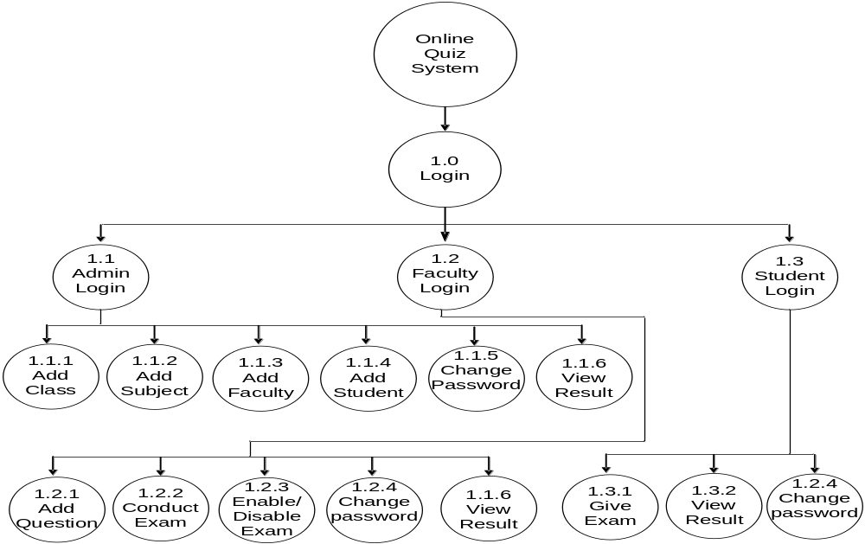
Process Chart
Online Quiz System

Slide 15
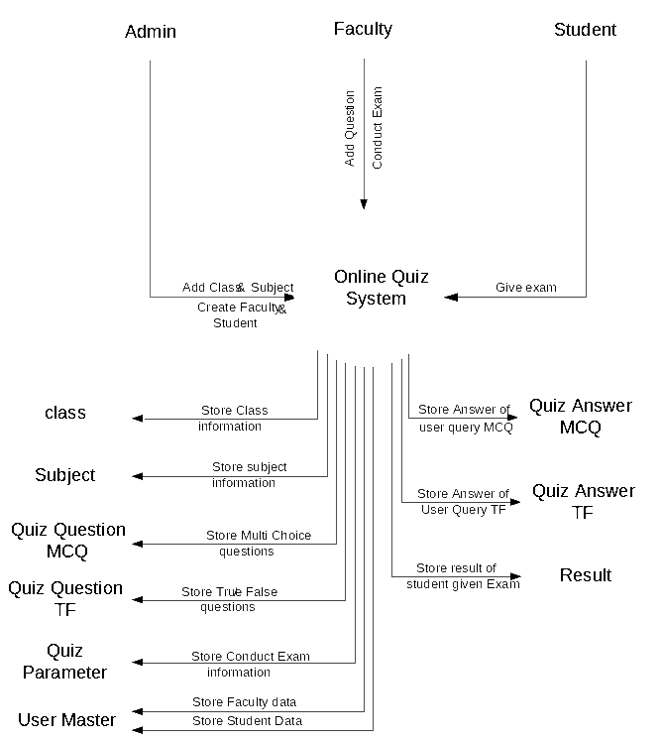
Context Level DFD
Online Quiz System

Slide 16
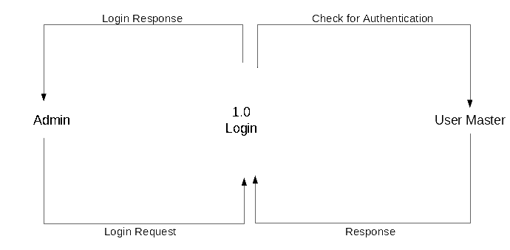
1-Level DFD
Online Quiz System

Slide 17

1-Level DFD
Online Quiz System

Slide 18
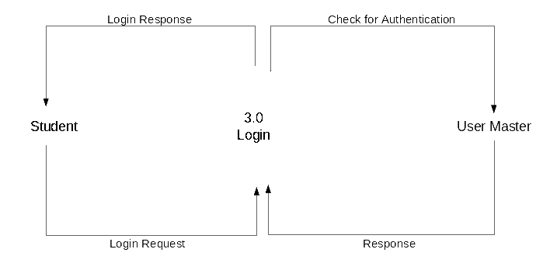
1-Level DFD
Online Quiz System

Slide 19
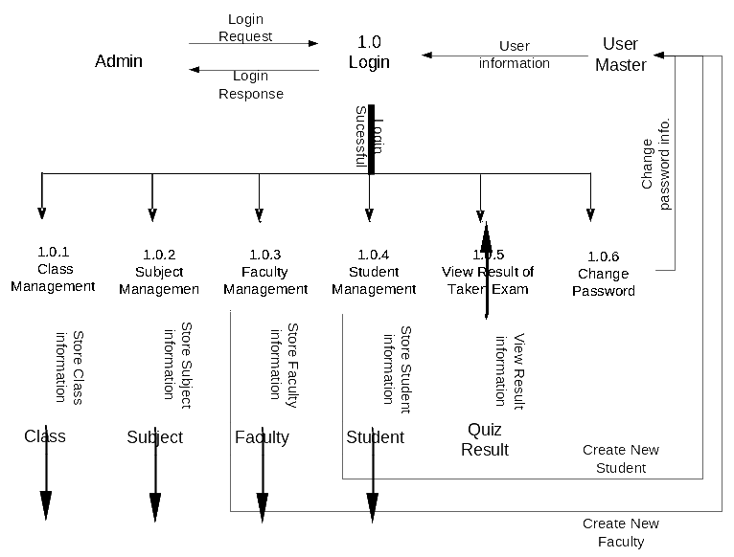
2-Level DFD For Process 1.0
Online Quiz System

Slide 20
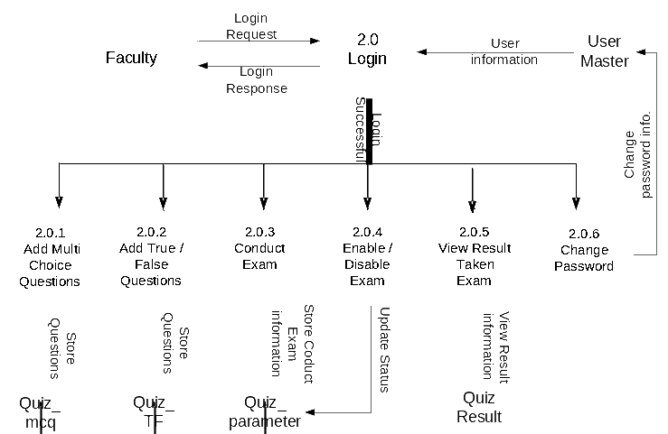
2-Level DFD For Process 2.0
Online Quiz System

Slide 21
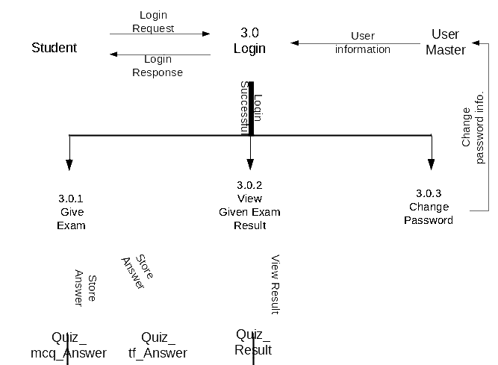
2-Level DFD For Process 3.0
Online Quiz System

Slide 22
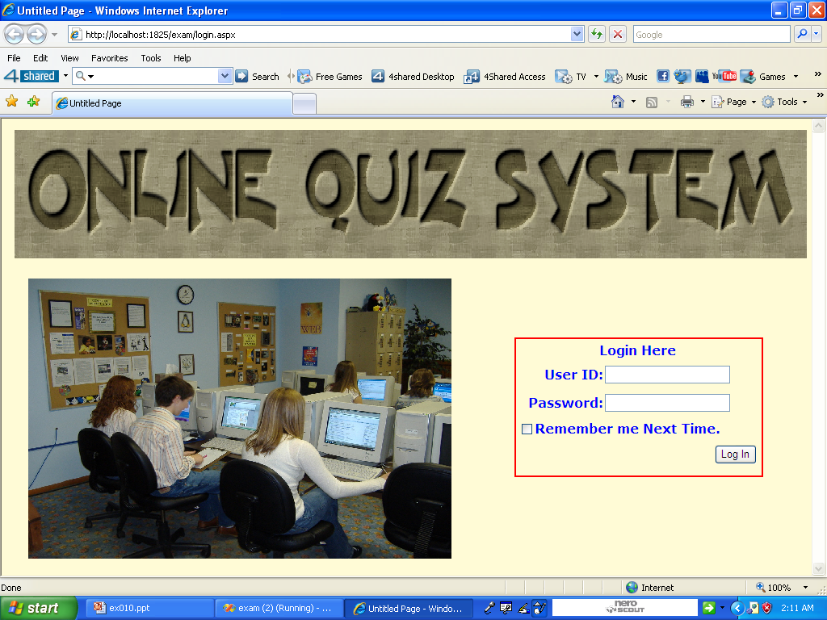
System Output 1.Login page
Online Quiz System

Slide 23
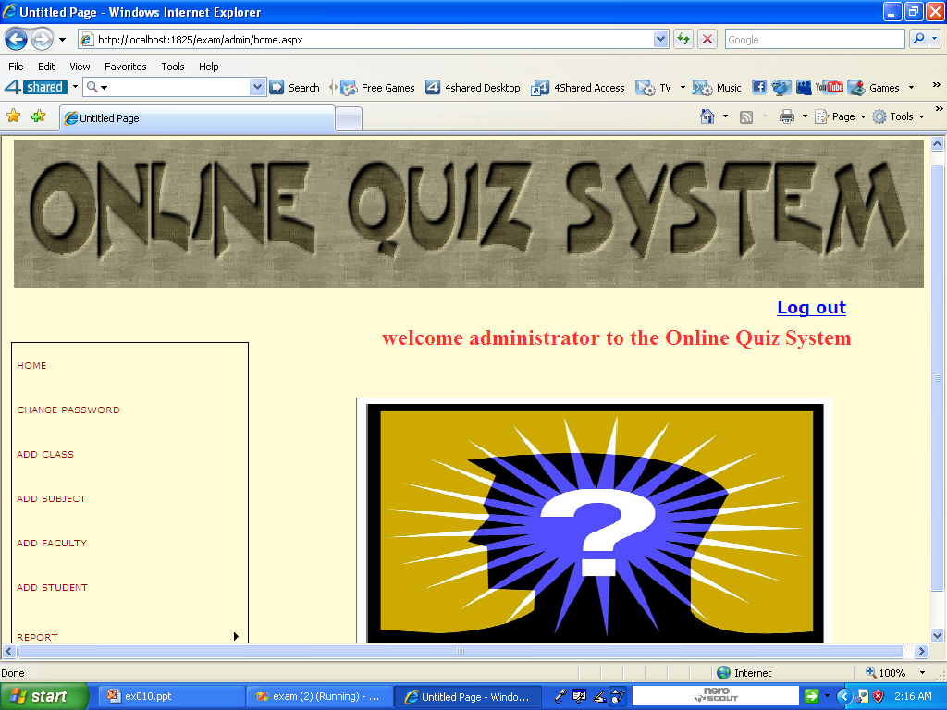
System Output 2.Admin Home page
Online Quiz System

Slide 24
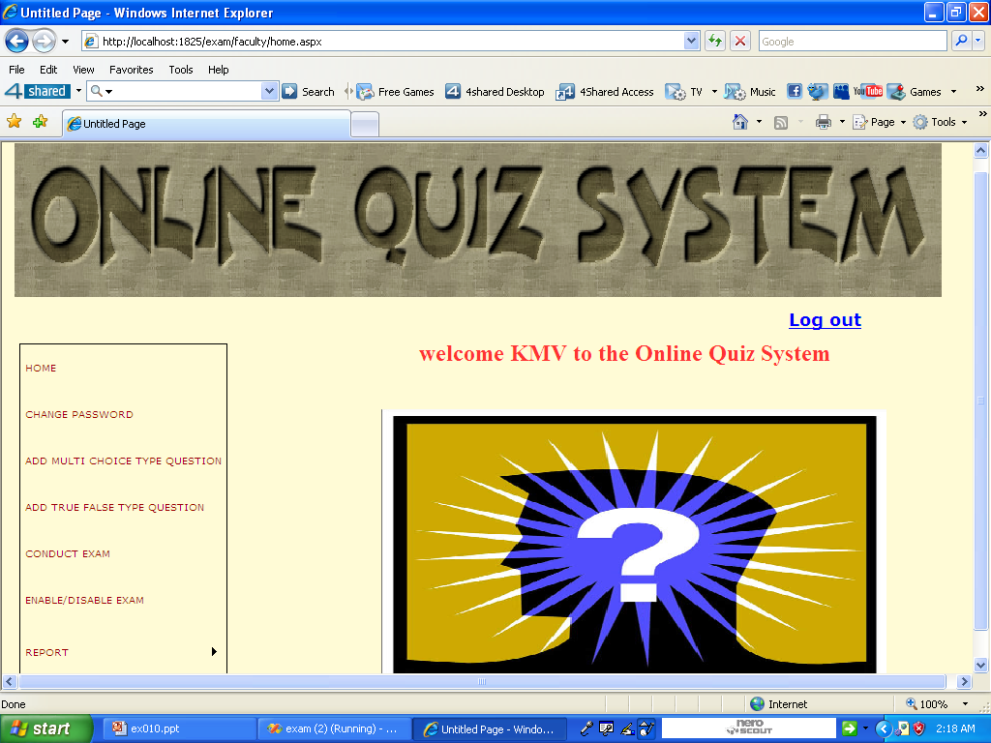
System Output 3.Faculty Home page
Online Quiz System

Slide 25
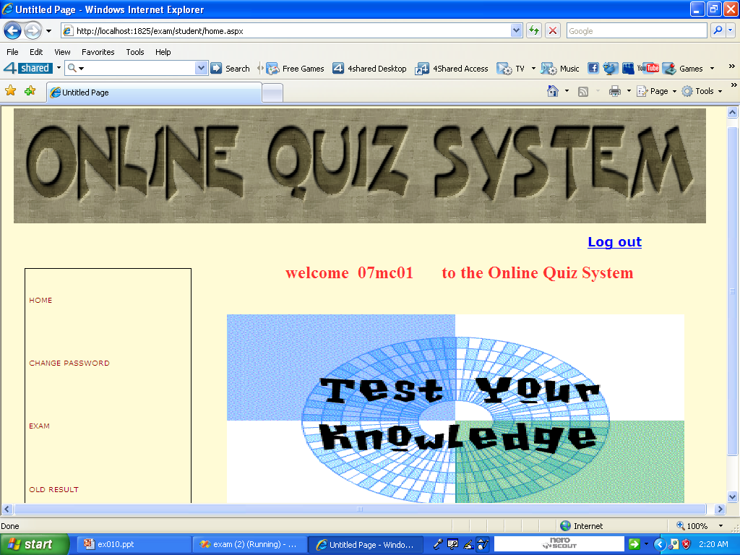
System Output 4.Student Home page
Online Quiz System

Slide 26
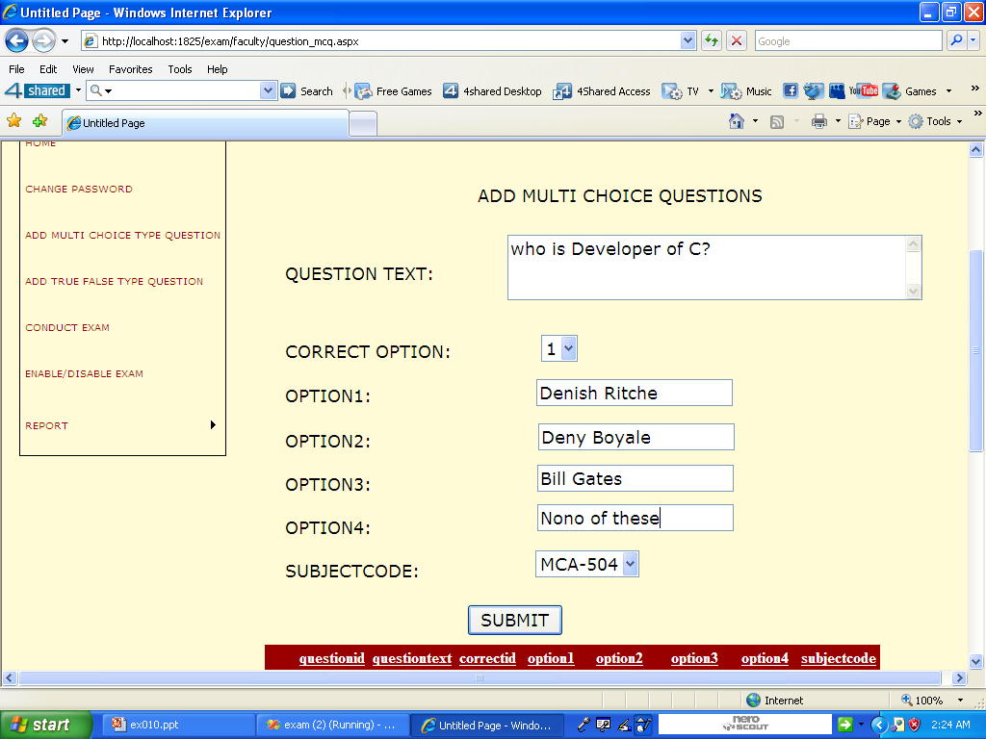
System Output 5.Add Questions page
Online Quiz System

Slide 27
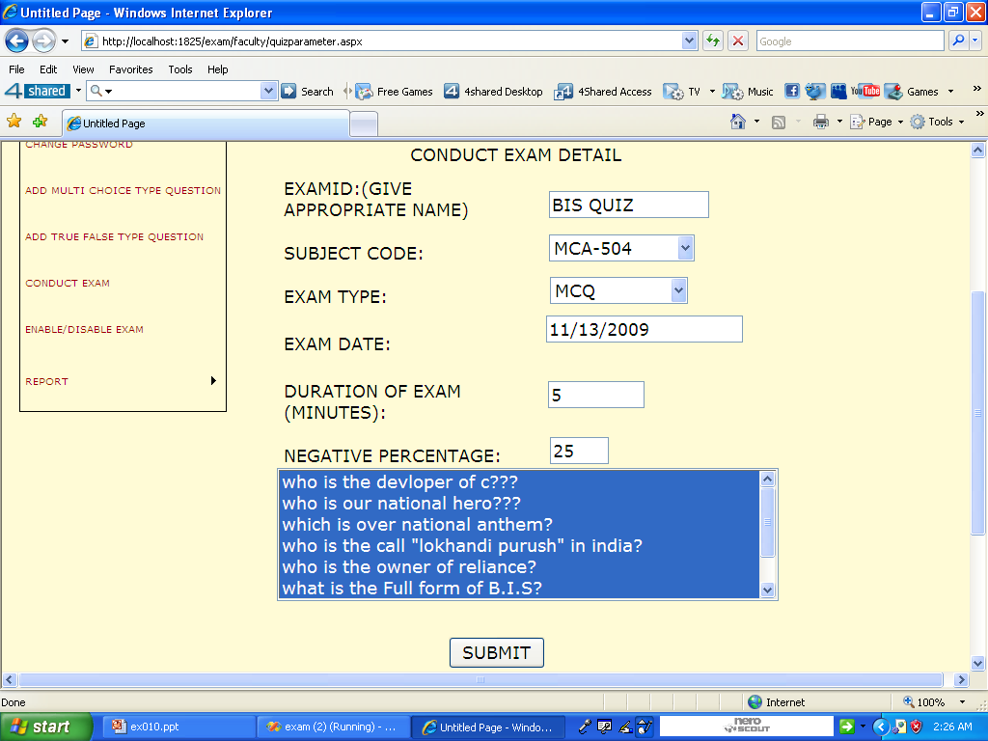
System Output 6.Conduct Exam page
Online Quiz System

Slide 28
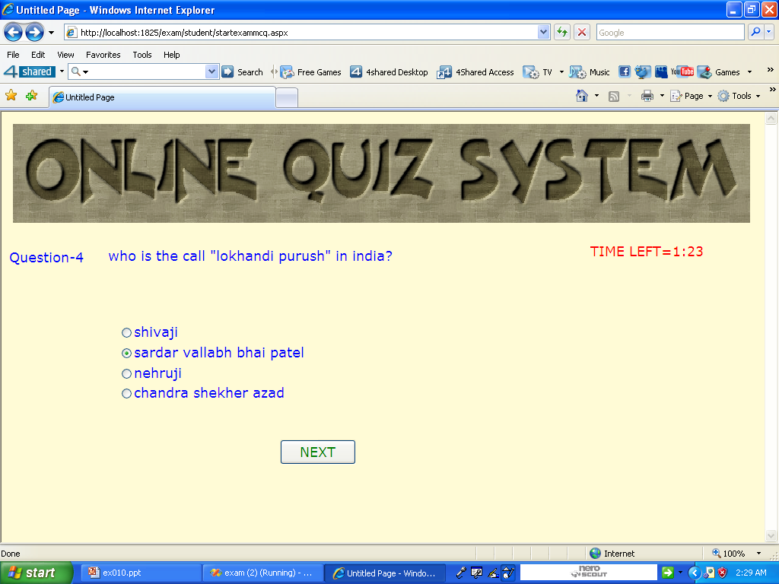
System Output 7.Exam page
Online Quiz System

Slide 29
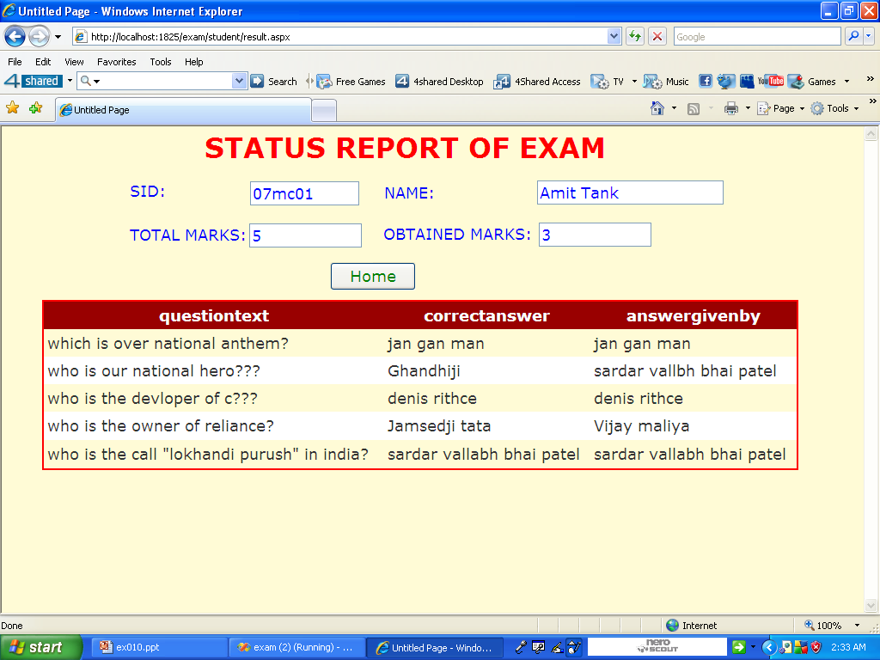
System Output 8. Result page
Online Quiz System

Slide 30
Thank YOU

